Slide 1
Software Quality Engineering
BS(SE)-VI
Software Product Quality Metrics
Dr Uzair Iqbal Janjua
Department of Computer Science
COMSATS University Islamabad, Islamabad Campus

Slide 2
Software Quality Engineering
BS(SE)-VI
“You can’t control what you can’t measure.”
Tom DeMarco (1962)

Slide 3
Objectives of software quality metrics
To assist management to monitor and control development and maintenance of software systems and their process improvements by:
Observing the conformance of software product to functionality and other requirements, regulations, and conventions.
Serving as a data source for process improvement by:
Identifying cases of low performance requiring improvement.
Demonstrating the achievements of process improvement proposals (corrective actions)

Slide 4
The metrics’ required characteristics
In order for the selected quality metrics to be applicable and successful, both favorable metrics characteristics and metrics implementation characteristics are required.
The metrics characteristics include being relevant, valid, reliable, comprehensive, and mutually exclusive.
The three metrics implementation characteristics are: being easy and simple, not requiring independent data collection, and immune to biased intervention by interested parties

Slide 5
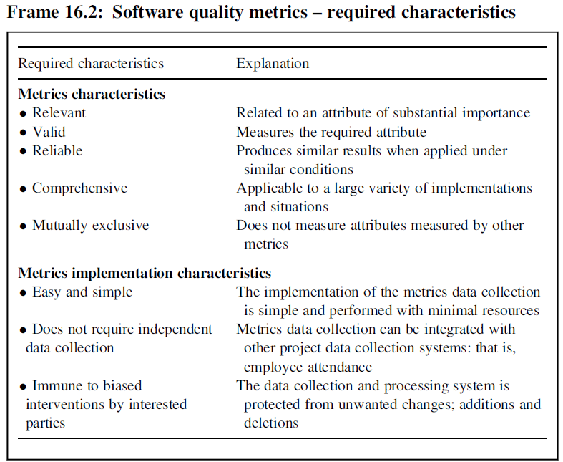
The metrics’ required characteristics

Slide 6
Implementation of software quality metrics
Several books, book chapters, and numerous journals as well as conference papers have been dedicated to the subject of software quality metrics.
A comprehensive presentation of software product metrics is provided by the four-part ISO/IEC Std. 9126 (ISO/IEC 2002–2004) (ISO/IEC, 2002).
The implementation of software quality metrics
Product metrics and their classification
Software product size metrics
Software attribute metrics

Slide 7
1.Implementation of software quality metrics
The implementation of software quality metrics in an organization includes the following activities:
Definition of software quality metrics–relevant and adequate for teams, departments, and so on.
Regular application of the metrics (by units, project teams, etc.)
Analysis of metrics data by the Corrective Action Board (CAB)
Taking action in response to metrics analysis results
Let discuss in detail these activities in further slides

Slide 8
1. Definition of software quality metrics
The definition of metrics involves a four-stage process:
Listing attributes to be measured: software quality, development team productivity, and so on.
Defining metrics that measure the required attributes and confirmation of their adequacy in complying with the requirements listed in Frame 16.2.
Determining comparative target values based on standards, previous year’s performance, and so on. These values serve as indicators to whether the unit measured (a team, individual, or portion of a software package) complies with the characteristics demanded of a given attribute.
Determining the metrics application processes: (1) Reporting method, including reporting process and frequency of reporting. (2) Metrics data collection method.

Slide 9
2. Application of the metrics
The process of applying a metric or set of metrics is similar to the implementation of new procedures or methodologies. It involves:
Assigning responsibility for reporting and metrics data collection.
Instruction of the team regarding the new metrics.
Follow-up includes:
(1) Support for solving application problems and provision of supplementary information when needed.
(2) Control of metrics reporting for completeness and accuracy.

Slide 10
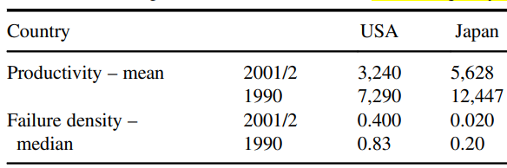
3. Analysis of metrics data by the Corrective Action Board
The Corrective Action Board (CAB) should perform analysis on the metrics’ results, in order that the metrics data be a valuable part of the SQA process.
Statistical tools may be used to identify any significant results. Analysis of these significant results is expected to lead to process improvements.

Slide 11
4. Taking action in response to metrics analysis results
The statistically analyzed metrics data provides opportunities for comparing a series of project metrics.
These certainly include comparison of metric results against predefined indicators, as well as comparisons with former projects or team performance during different periods of time, and so on.
Another important comparison relates to the effectiveness with which the metrics themselves fulfill their respective objectives.

Slide 12
4. Taking action in response to metrics analysis results
The following questions are just a sample of those that may be asked with respect to the metrics portion of the SQA process.
• Are there significant differences between the HD teams’ quality of service?
• Do the metric results support the assumption that application of the new version of the development tool contributes significantly to software quality?
• Do the metric results support the assumption that reorganization has contributed significantly to a specific team’s productivity?
The actions taken in response to metrics analysis as well as the developments in the organization and its environment are mainly initiated by the Corrective Action Board (CAB).

Slide 13
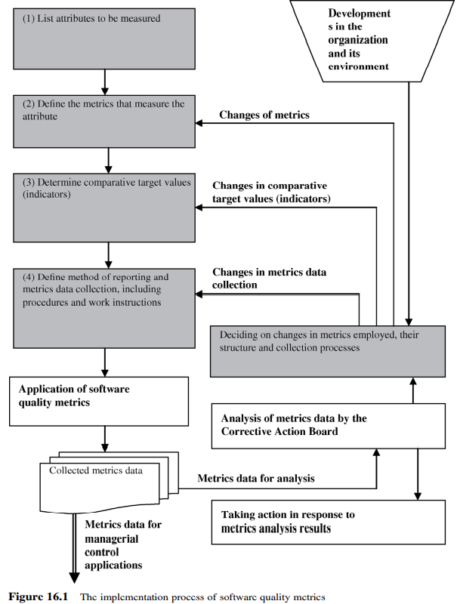
Taking action in response to metrics analysis results

Slide 14
2. Product metrics and their classification
Software process metrics are a quantitative representation of software processes, as experienced by developers and maintainers throughout the software life cycle, such as, prerelease defects, percent of modified code lines, and density of detected defects.
Software product metrics are a quantitative representation of software products or intermediate product’s attributes, as experienced by the user when applying the software trying to adapt it or change it, such as size, effectiveness, productivity, and reliability
The product metrics are classified into two classes:
Software product size metrics
Software attributes metrics

Slide 15
3. Software product size metrics
A measure of software product size is needed mainly:
to estimate the required development resources at the stage of preparing a proposal for a software project or planning and scheduling its process of development and
for use in other metrics when comparing the performance proportionally to the software project size, for example, in metrics of productivity, quality (defects rates), and so on.
Two approaches for software size metrics are offered:
Thousands Off Lines of Code (KLOC).
Function points (FPs).

Slide 16
3. Software product size metrics
Thousands Off Lines of Code (KLOC).
This metric represents metrics based on the physical completed size of software, such as the number of lines of code or the number of software statements. While the application of this metric is very simple, once the software project is completed, its application during the early stages of development is very inaccurate. Estimates of the expected KLOC size of a planned project rely only on the personal experience of the evaluators, and the impression they form when examining the project specifications

Slide 17
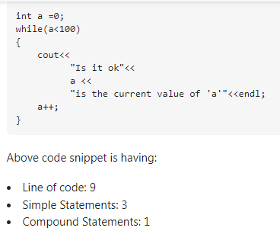
3. Software product size metrics
Thousands Off Lines of Code (KLOC).

Slide 18
3. Software product size metrics
Function points (FPs).
This metric represents the result of applying a measure from the group of functional size measurement (FSM) methods.
The FSM concept requires counting items such as inputs and outputs of software systems, software transactions, and logical file systems derived directly from the requirement specifications where the level of complexity/difficulty is evaluated for each item, and an adequate factor is defined accordingly.
• What is the average number of programming logical statements per function point?
• What is the average productivity of a staff member in terms of the number of function points produced per month?

Slide 19
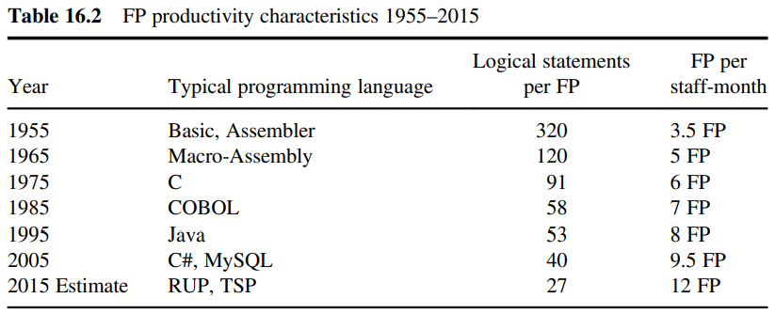
3. Software product size metrics

Slide 20
4. Software product attribute metrics
The ISO/IEC technical reports relate to 10 attributes of software products, which are as follows:
Software functionality
Software reliability
Software usability
Software efficiency
Software maintainability
Software portability
Software effectiveness
Software productivity
Software safety
Software satisfaction

Slide 21
Entities and Attributes
Attributes are characteristics or properties of entities.
E.g. a person (entity) can be described by characteristics such as height, colour of eyes, sex, IQ, age, and years of experience (attributes).
Software entities be described by attributes such as size, cost, elapsed time, effort expended, response time, transaction rates, number of defects found, and operational reliability.

Slide 22
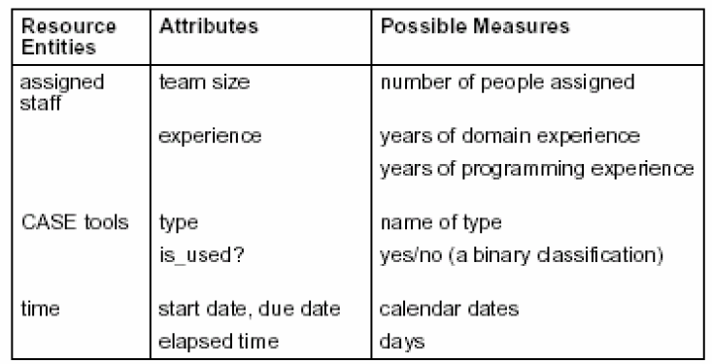
Resource Measures (Entities)

Slide 23
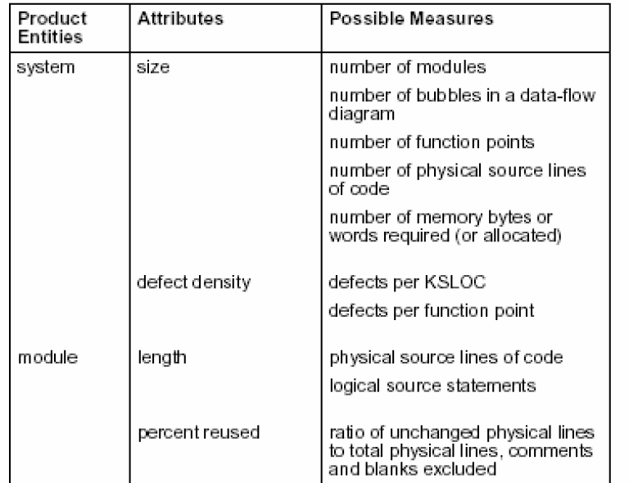
Product Measures (Entities)

Slide 24
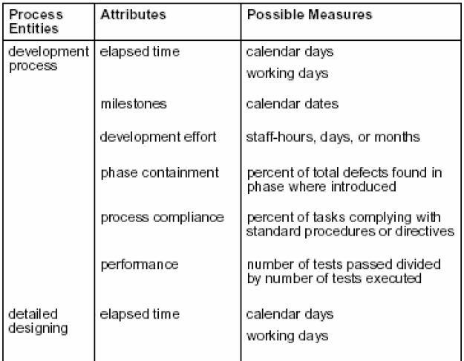
Process Measures (Entities)

Slide 25
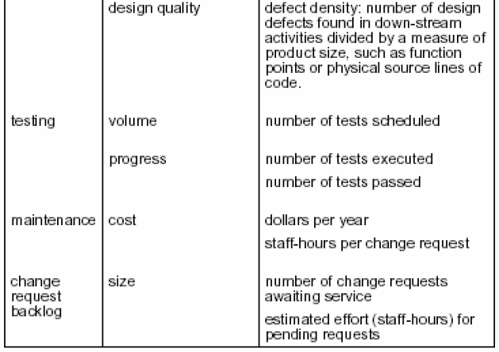
Process Measures (Entities)

Slide 26
Function-Oriented Metrics
The following Five information domain characteristics are determined:
Number of user inputs (External Input (EI))
Number of user outputs (External Output (EO))
Number of user inquiries (External Inquiry (EQ))
Number of files (Internal Logical Files (ILF))
Number of external files(External Interface Files(EIF))

Slide 27
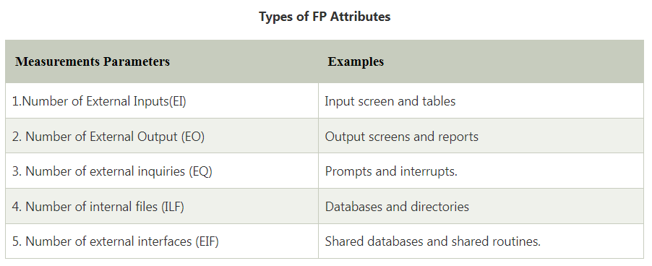
Function-Oriented Metrics

Slide 28
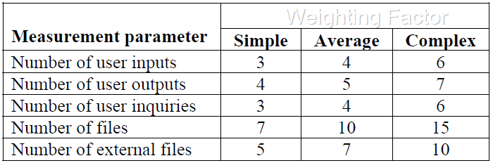
Function-Oriented Metrics –Weighting Factors
Once the data about information domain has been collected, a complexity value is associated with each count.
The complexity may be simple, average, or complex. A weighting factor is associated with complexity value as shown below:

Slide 29
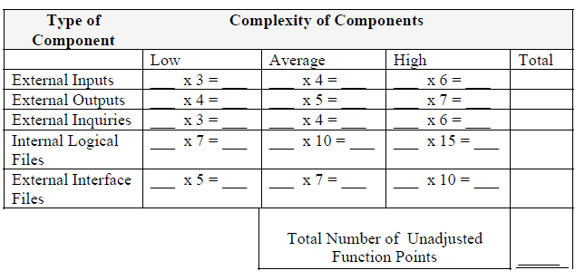
Function-Oriented Metrics –Weighting Factors

Slide 30

Function-Oriented Metrics –Weighting Factors
With the weighting factors, the first step is to calculate the function points (FCs) based on the following formula:
Where x_{i} is the counts for each of the five components and w_{ij} is the corresponding weighting factor.
The second step involves a scale from 0 (not important or applicable) to 5 (absolutely essential) to assess the impact of 14 general characteristics in terms of their likely effect on the application

Slide 31
Function-Oriented Metrics –Weighting Factors
The 14 General characteristics
Data communications (are data communications required?)
Distributed functions (Are there distributed processing functions?)
Performance (Is performance critical?)
Heavily used configuration (Will the system run in an existing, heavily utilized operational environment?)
Transaction rate
Online data entry
End-user efficiency
Online update
Complex processing
Reusability
Installation ease
Operational ease
Multiple sites
Facilitation of change

Slide 32

Function-Oriented Metrics –Weighting Factors
The scores (ranging from 0 to 5) for the above characteristics are then summed up, based on the following formula:
Where C_{i} is the score for general system characteristic i.
Finally, the number of function points is obtained using the following formula:
FP = Unadjusted Function Points× Value Adjustment Factor
FP = FC×VAF
Once function points have been calculated, they are used in a manner similar to LOC as a way to normalize measures for software productivity, quality, and other attributes.

Slide 33
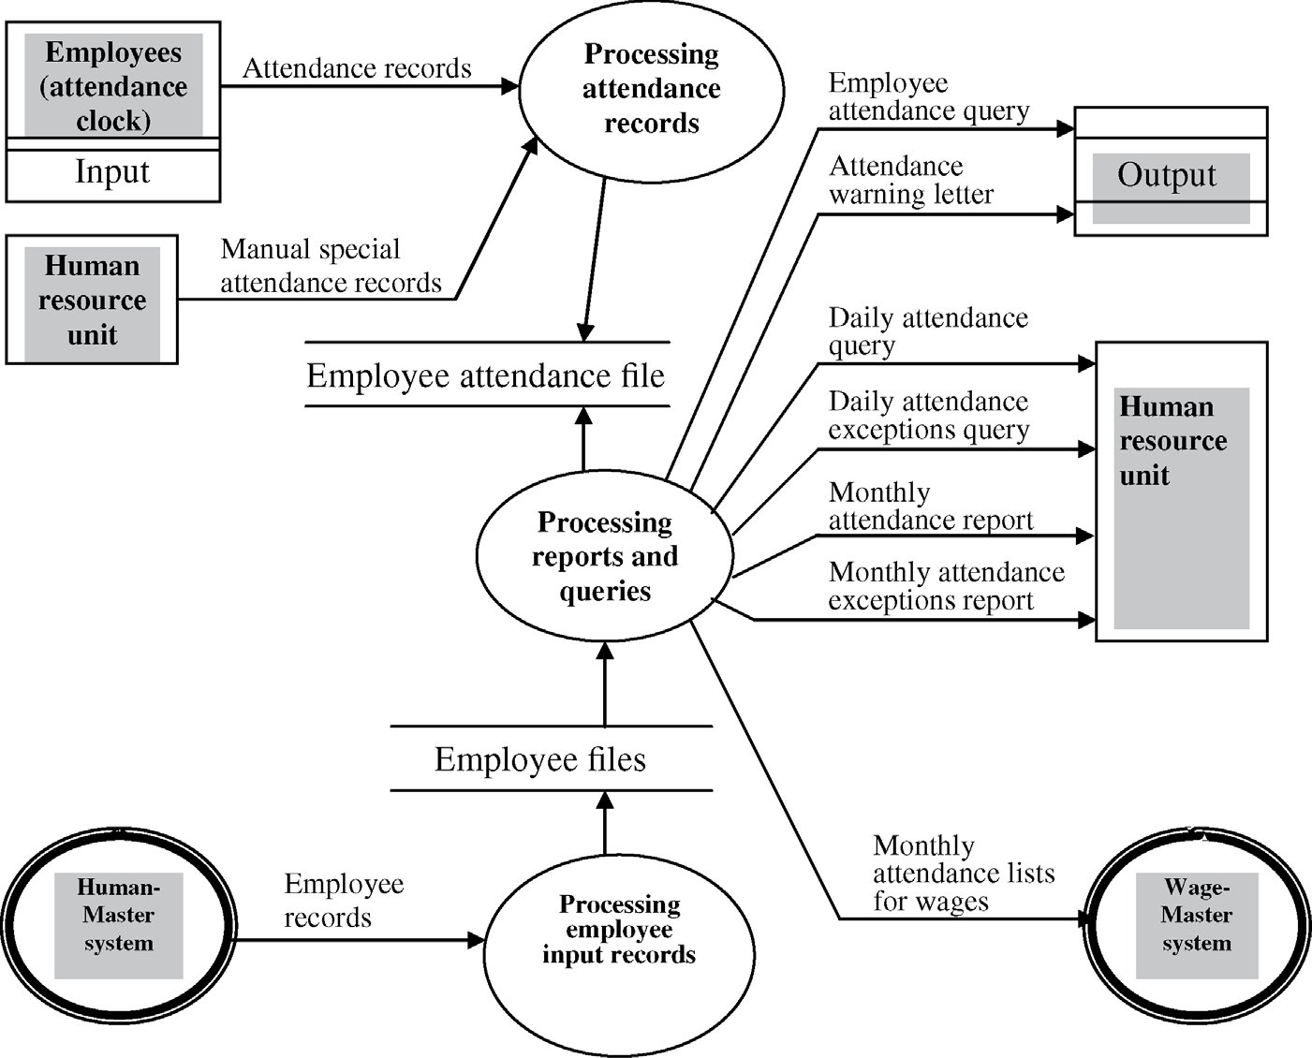
Functional Point Example 1

Slide 34
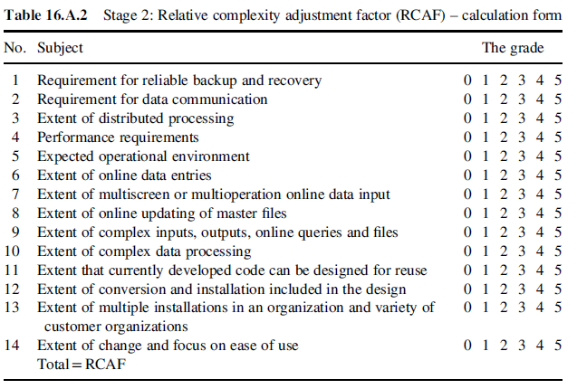
Functional Point Example 1

Slide 35
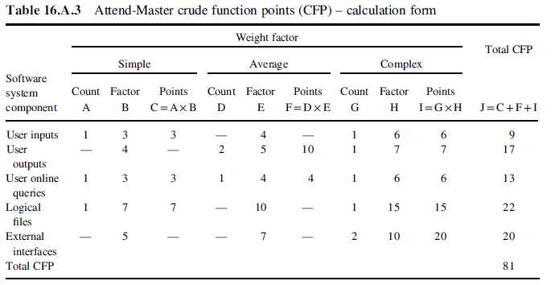
Functional Point Example 1

Slide 36
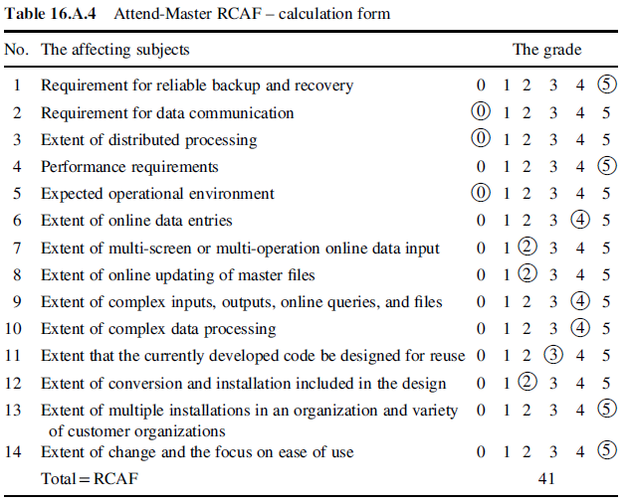
Functional Point Example 1

Slide 37
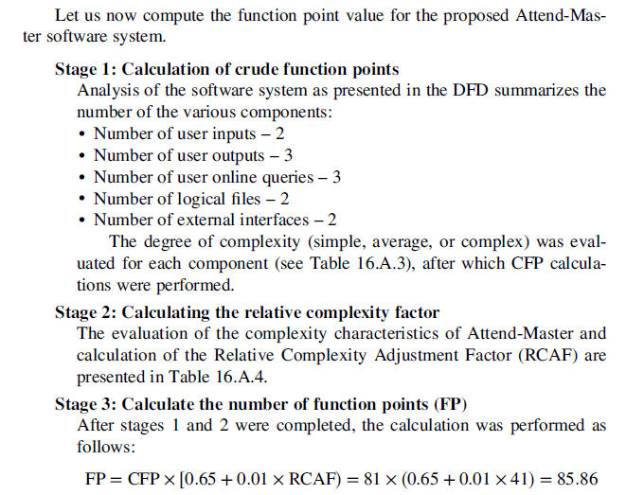
Functional Point Example 1

Slide 38
Functional Point Example 2
For the Given the following values, Compute Functional Point (F.P) when all complexity adjustment factors (CAF) and weighting factors are average.
Functional Unit | Values | Weighting Factor
 |  | Low | Average |  | High
User Input | 50 | 3 | 4 | 6
User Output | 40 | 4 | 5 | 7
User Enquires | 35 | 3 | 4 | 6
User File | 6 | 7 | 10 | 15
External Interface | 4 | 5 | 7 | 10

Slide 39
Functional Point Example 2
Step 1
Each Function Point is ranked according to complexity. There exists predefined weight for functional point in each category. In the above given data the weight of each functional point is average i.e. 4, 5, 4, 10 and 7.
Step 2
Calculate the unadjusted function point by multiplying each functional point by its corresponding weight factor

Slide 40

Functional Point Example 2
Functional Unit | Values | Weighting Factor
User Input | 50 | 4 | 200
User Output | 40 | 5 | 200
User Enquires | 35 | 4 | 140
User File | 6 | 10 | 60
External Interface | 4 | 7 | 28
Total |  |  | 628
Step 3
Calculate final function point
CAF= [0.65 + {0.01* (14*3 )}]
CAF = 1.07
Final F.P = FC * CAF
Final F.P = 628 * 1.07
Final F.P =671.96

Slide 41
Functional Point Example 3
Based on the FP measure of software many other metrics can be computed:
Errors/FP
$/FP.
Defects/FP
Pages of documentation/FP
Errors/PM.
Productivity = FP/PM (effort is measured in person-months).
$/Page of Documentation.
LOCs of an application can be estimated from FPs. That is, they are interconvertible. This process is known as backfiring. For example, 1 FP is equal to about 100 lines of COBOL code.

Slide 42
Functional Point Example 3
Example: Compute the function point, productivity, documentation, cost per function for the following data:
Number of user inputs = 24
Number of user outputs = 46
Number of inquiries = 8
Number of files = 4
Number of external interfaces = 2
Effort = 36.9 p-m
Technical documents = 265 pages
User documents = 122 pages
Cost = $7744/ month
Various Weight Factors respectively are 4,4,6,10,5
Various processing complexity factors are: 4, 1, 0, 3, 3, 5, 4, 4, 3, 3, 2, 2, 4, 5

Slide 43
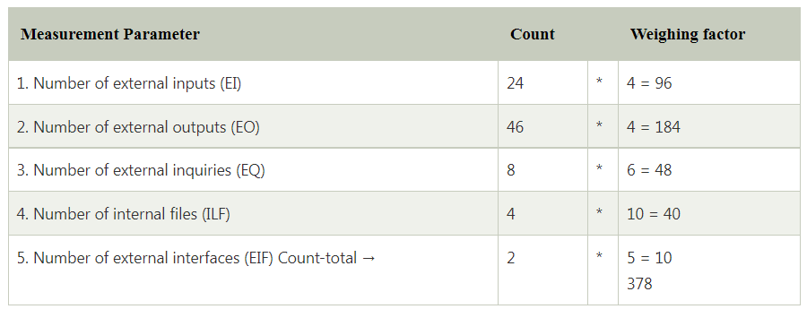
Functional Point Example 3

Slide 44
Functional Point Example 3
So sum of all f_{i} (i ← 1 to 14) = 4 + 1 + 0 + 3 + 5 + 4 + 4 + 3 + 3 + 2 + 2 + 4 + 5 = 43
FP = Count-total * [0.65 + 0.01 *∑(f_{i})] = 378 * [0.65 + 0.01 * 43] = 378 * [0.65 + 0.43] = 378 * 1.08 = 408

Slide 45
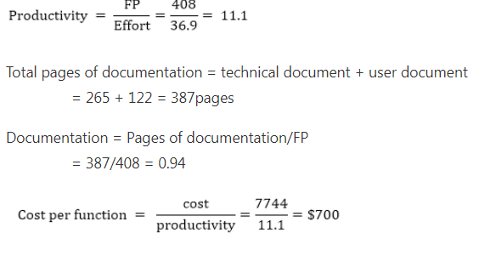
Functional Point Example 3

